Slide 1

EOH-MC Solutions
A client-centric approach, passion for technology & innovation that will drive real value into your business.
Hacking 101
Secure Coding
.
Presented By:
Pieter Myburgh

Slide 2
Hacking 101 – Secure Coding
Agenda:
Hacking 101
What is Hacking
Hacker Types
Kali Linux 101
What is Kali Linux
Hacker Toolset
Secure Coding 101
OWASP Top 10
Authentication and authorization flaws
Client side attacks
Server side attacks
Cryptography
Third party vulnerabilities
Integrating Security
Mobile application

Slide 3

“If you go to a coffee shop or at the airport, and you're using open wireless, I would use a VPN service that you could subscribe for 10 bucks a month. Everything is encrypted in an encryption tunnel, so a hacker cannot tamper with your connection.”
Kevin Mitnick
Notes:
Kevin David Mitnick is an American computer security consultant, author and hacker, best known for his high-profile 1995 arrest and later five years in prison for various computer and communications-related crimes.
Movie: Track Down, Also know as Hackers 2 – Operation Takedown, Released in 2000

Slide 4
Hacking 101 – Secure Coding
Hacking 101.
What is Hacking?
gain unauthorized access to data in a system or computer.
Hacker Types:
Crackers
Black Hat
1337
Grey Hat
Skids (Script Kiddies)
Hackers
Pen Testers
White Hat

Slide 5
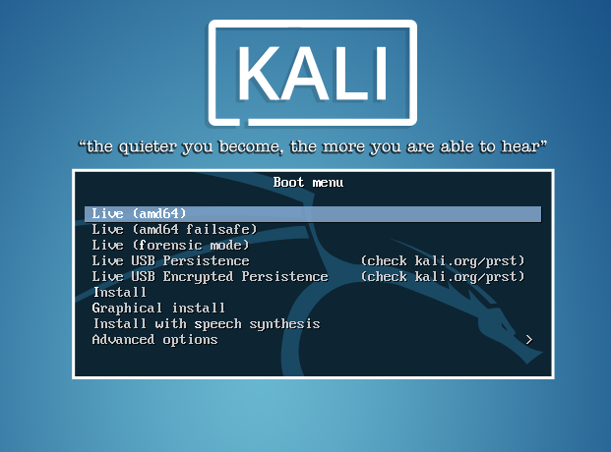
Hacking 101 – Secure Coding
Kali Linux
What is Kali Linux
Kali Linux is a toolset of some of the best hacker tools out there.

Slide 6
Hacking 101 – Secure Coding
Kali Linux
Download the latest ISO here:
https://www.kali.org/downloads/
ALWAYS CHECK THE SHA1Sum
Make it Persist
http://docs.kali.org/downloading/kali-linux-live-usb-persistence

Slide 7
Hacking 101 – Secure Coding
OWASP top 10.
What is OWASP?
https://www.owasp.org/
The Open Web Application Security Project (OWASP) is an open community dedicated to enabling organizations to develop, purchase, and maintain applications that can be trusted.
At OWASP you’ll find free and open
Application security tools and standards
Complete books on application security testing, secure code development, and secure code review
Standard security controls and libraries

Slide 8
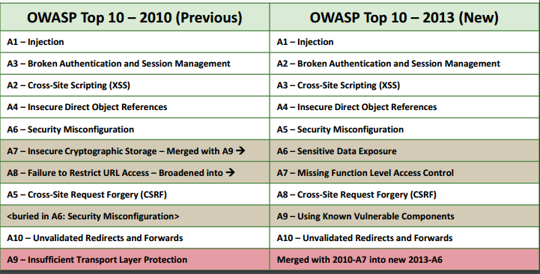
Hacking 101 – Secure Coding
OWASP top 10.

Slide 9
Hacking 101 – Secure Coding
Secure Coding 101
Authentication and authorization flaws
Understanding Authentication and Authorization and the common flaws that affect Authentication and Authorization of web applications.
Client side attacks
Understanding attacks that target the users of the application.
Server side attacks
Understanding attacks that target the server.

Slide 10
Hacking 101 – Secure Coding
Secure Coding 101
Cryptography
Introduction to core concepts and uses of cryptography and understanding of common cryptography misconceptions.
Third party vulnerabilities
Understanding of security issues introduced by the user of third­party components or by an incorrectly configured infrastructure.
Integrating Security
Understanding of integrating security into Software Development Lifecycle (SDLC).

Slide 11
Hacking 101 – Secure Coding
Secure Coding 101
Mobile application
Introduction to the threats and the common vulnerabilities faced by mobile applications.

